Slide 1
Python Forensic Investigation Findings
CLIENT: Brett Miller
IA 495 Capstone
Instructor: Dr. Tout
Assistant: Pooja Patil
Project Dates:
1/23/2021 --> 4/17/2021

Slide 2

Python: Project Team
Alex Peplinski
Antonio Bally
Brandon Paul
Kyle Purchase

Slide 3

Investigation: Goals
Identify Methods
Identify Imports
Identify Constants
Present to the customer Python Report

Slide 4

Initial Approach
REGEX
Dynamic vs Static Analysis
System configuration changes
Typosquatters
Credential scanning
Network scanning, outbound connections
Notes:
-Kyle
Notes-
Dynamic Vs Static: Dynamic-install package in a sandbox, observe what it does
Static-Analyze code without executing it
Typosqautters: when a malicious library is spelt similarly to the actual non malicious library. This is more a human error that can be corrected just be keeping an eye out on spelling, and not guessing package names.
Most attacks in PyPi so far involve using setup.py and having the malicious code inside that setup.py file which is used by the machine to get the package and machine ready for installation of said package.

Slide 5
Initial Approach #2
Inline dll hooking.
Sandboxing , IANA alert level
Check if files are moved to a particular spot.
Catching crypto mining
Checking pre scheduled tasks.
Reading RAM or CPU high alert,
Notes:
-Kyle
Inline hooking: Taking the first bytes of an api method call and redirecting the code execution to something else.
Checking for if anything malicious happened wasnt practical to our assignment as it wasnt actually doing any preventive measures but more being passive alert like and IDS. We want more of like an IPS system for what we are doing.
Constantly reading RAM and CPU isn't practical in the sense of preventive measures against for example crypto mining

Slide 6
Initial Approach #3
Band word list
machine learning
Enneagram of python analysis
Anomaly detection
gcc firing up
look at truffle hog.
Notes:
-Kyle
machine learning, could we use machine learning to keep a repository of all malicious packages and deny them? Not practical as it wouldnt prevent any new malicous packages from being installed.
Enneagram of python analysis - ???
trufflehog - will search through git repositories, run entropy checks or high signal regex checks. Uses Shannon entropy checks. Practical for the project, took inspiration from it.

Slide 7

Actual Approach
Black Hat Python
Seitz, J. (2015).
Black Hat Python:
Python Programming for Hackers
and Pentesters, San
Francisco: No Starch Press, Inc.

Slide 8
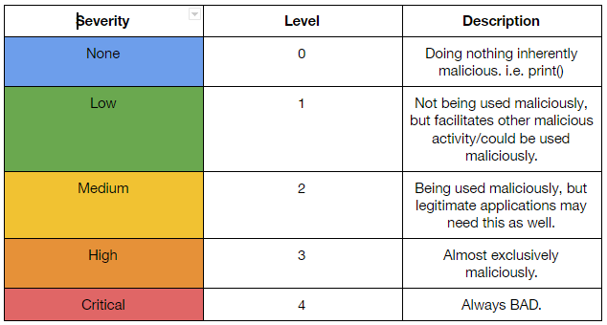
Severity Score Table

Slide 9
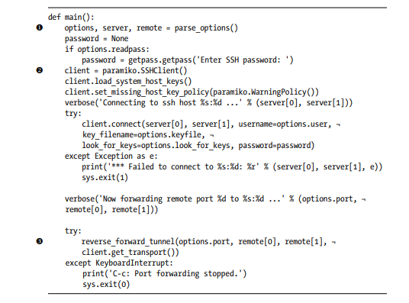
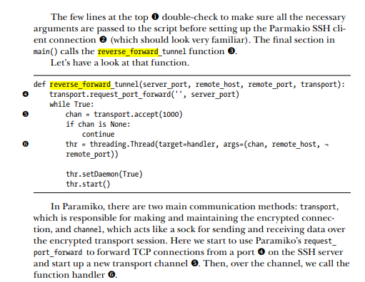
Malicious Script Example

Slide 10
Program Design

Slide 11
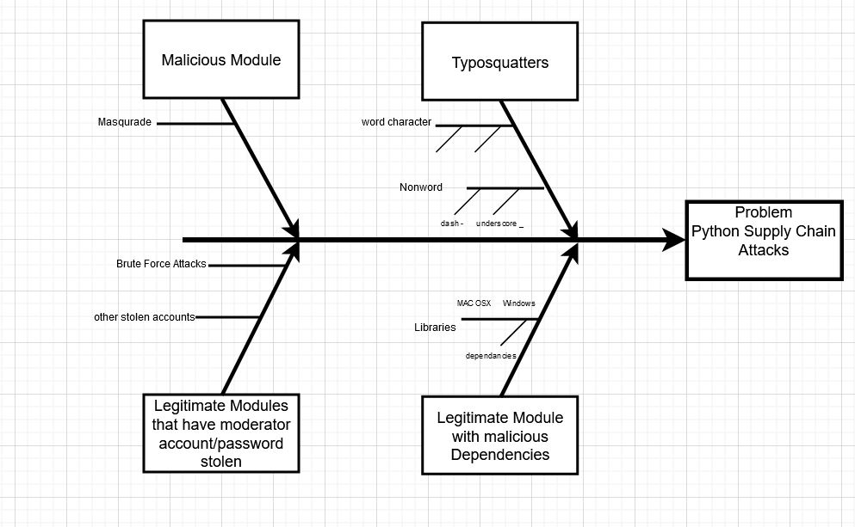
Actual Approach
Notes:
fishbone chart using draw.io
four vectors of attack

Slide 12
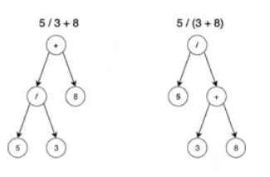
Actual Approach
Abstract Syntax Tree
AST
Notes:
Alex body is the entire tree, within that body we can check each node,

Slide 13
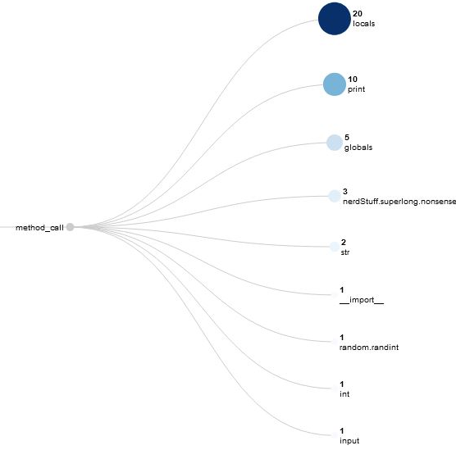
Abstract Syntax Tree
Enabled us to pull out
methods
Notes:
Alex
privilege escalation stuff. increase the severity
Python ---import functionality modified,-- not found locally,-- remotely retrieve the library from our Github repo.
a custom class to the sys.meta_path list

Slide 14
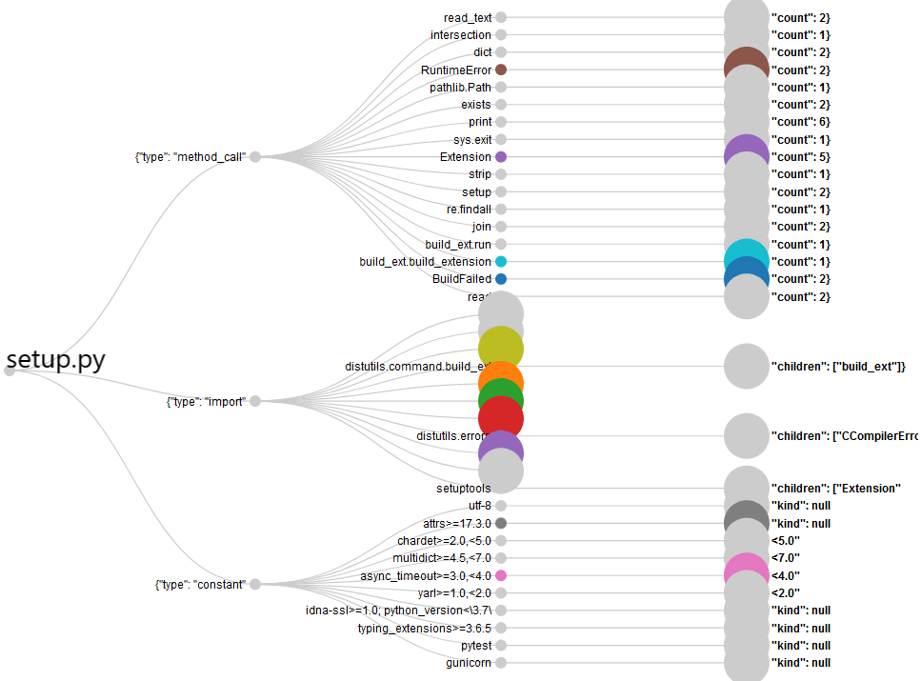
AST
imports
methods
constants
Notes:
3 ways -----from library import method-----import------import urllib.request
netcat replacement. lets say that you break into a system and they dont have netcat
you can program your own way to send files.
sys.modules # docs.python-- dictionary--- modules which have already been loaded.
-- can force modules to reload an

Slide 15
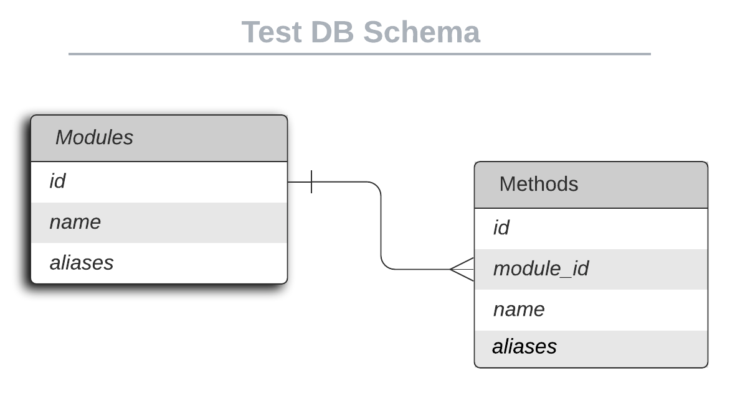
Lessons Learned
One example of what went right on this project:
AST instead of REGEX
One example of what went wrong on this project.
MySQL database
Notes:
sqllite-stripped down version of a oracle databasing.
someone has built a nice python module- push stuff to the database
alias or something we just need to make some foreign keys to link the child to the parent.
at least we know how to make tables,
in the from table we want to have a foreign eky that is going to be a modules . id

Slide 16
Investigation: Evidence Reviewed
Files:Setup.py
Websites:pypi.org
Notes:
decide between the xlm and json, for the report.
HTML file
structime = time.asctime(time.localtime(file_name))

Slide 17
Investigation: Tools/Methodology
VSCode
Abstract Syntax Tree module
Websites: Pypi.org
Github
Notes:
highlight item and ctrl + D to change all matches beneath,
Shift+ tab to de indent
ctrl+f works with regex little thing with a star
add a new line launch.json ( arguments)
multiline strings= """
main branch , change it to development

Slide 18
Investigation: Key Findings
we found the python scripts infiltrated using
windll
tunneling
Typosquatter found:boto3typeannotations 0.1.1

Slide 19
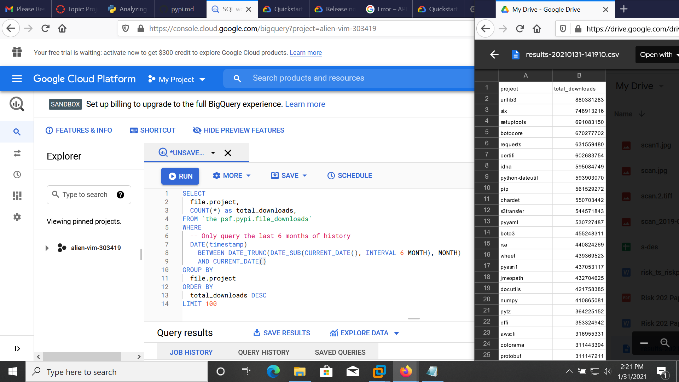
Lessons Learned
Notes:
100 items from the 856.1 GiB of data on the google cloud.
pypi.org "boto" bar - by relevance and the fifth line had "boto3typeannotations 0.1.1 A package do prevent Exploit."
William Bengston the very man who's article that started my search!
it just prints out a statement that tells the admin to install the correct package which has dashes "-" in the project name.

Slide 20

Entropy
Notes:
entropy called in main, and include it into the report
Pyhton 2 script by FB36 on code.activestate.com to python 3
Claude E. Shannon's entropy
It looks like their code gets ASCII values for each character in the file and then places them into a byteArr. I think it then tries to calculate the frequencies of each letter or character or symbol using a for loop. I think it then goes through list that was generated and does some funky Log math and appends/writes that to a variable with each loop, it then prints that final calculation"

Slide 21
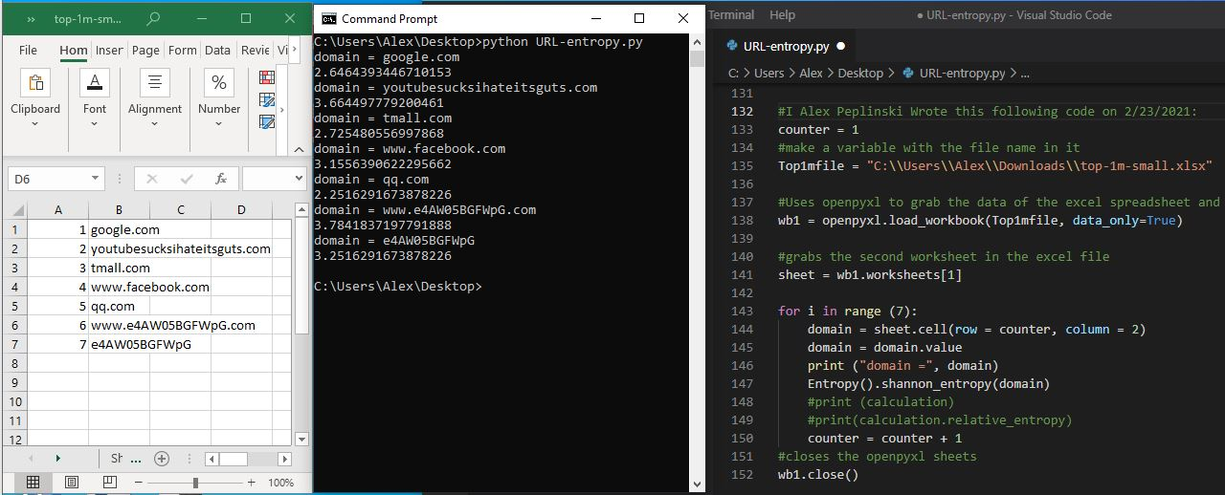
Entropy
Notes:
Alexa's top one million domain names from s3.amazonaws.com
Chilton
entering a garbage (malicous) domain name into the script to analyze the results
distinguishing between a normal English domain name and a possibly malicious domain name.

Slide 22
Environment

Slide 23
Replication
Machine with Python3
Syntax error free Python file
Browser

Slide 24
Arguments
--target
--filters
--keepNegatives
--outDir
--outName
--jsinDir
--jsinName
--cssFile
--test
python main.py --target <path to target file>
python main.py --target <target file> --filters <filter file>
python main.py --test

Slide 25
Results

Slide 26
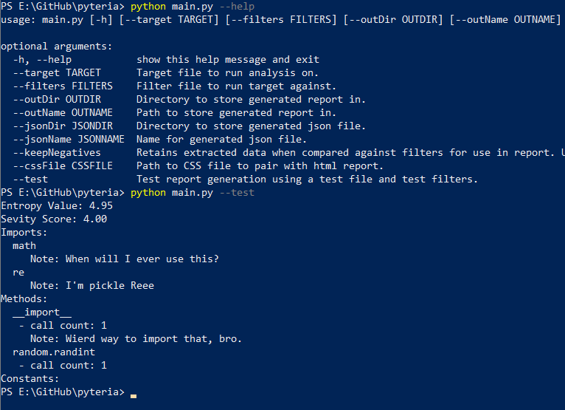
Results

Slide 27
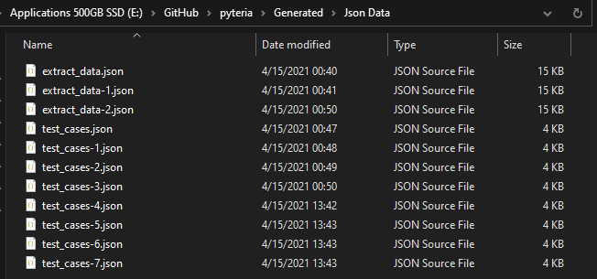
Results

Slide 28
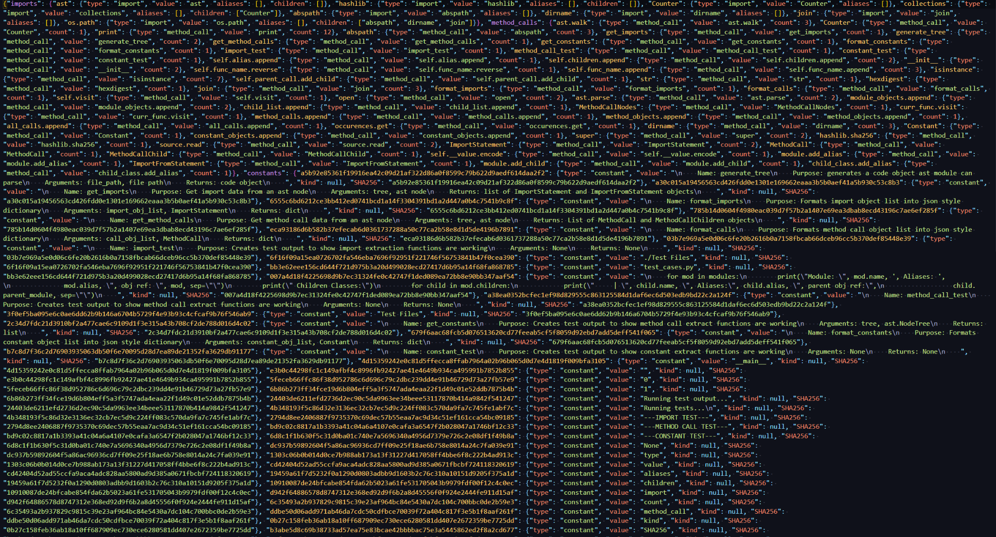
Results

Slide 29
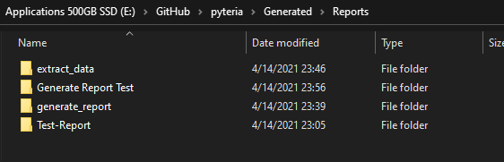
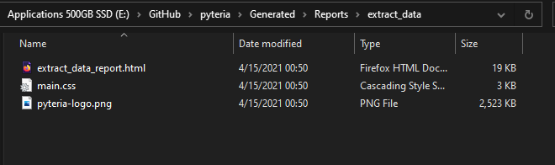
Results

Slide 30
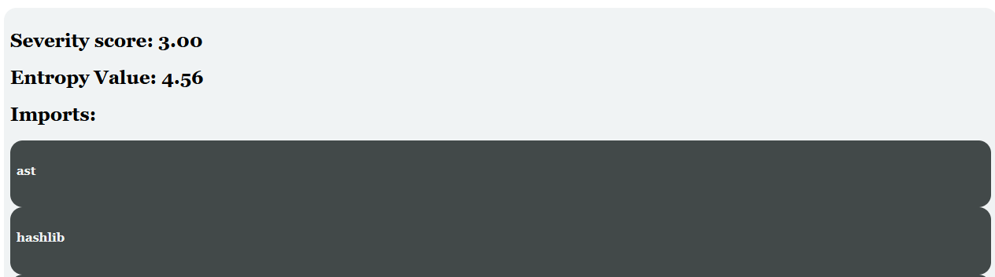
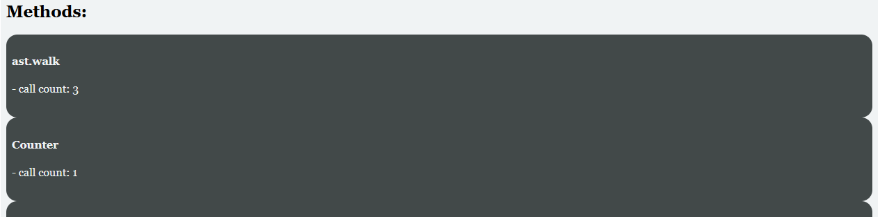
Results

Slide 31
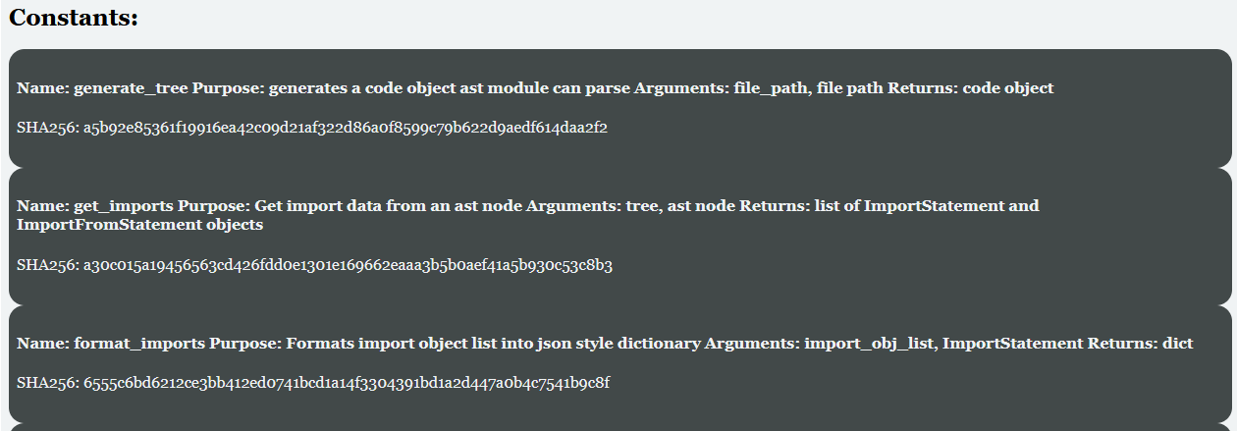
Results

Slide 32
Demo
fingers crossed...

Slide 33
Conclusion

Slide 34
Conclusion
Feasible to extract Python data
Difficult to find python malware samples
Maintaining filters is not viable
Other approaches would be preferable
AI
Community reporting
CVE integration
Further research

Slide 35
References
DensityDesign, Calibro, Inmagik, (2021). Raw Graphs retrieved from: https://app.rawgraphs.io/
Hartman, K., (2020) kennethghartman.com/calculate-file-entropy/
FB36 (2011) code.activestate.com/recipes/577476-shannon-entropy-calculation/#c3
https://blog.malwarebytes.com/threat-analysis/2018/04/pbot-python-based-adware/
https://discuss.python.org/t/what-methods-should-we-implement-to-detect-malicious-content/2240
https://www.cyborgsecurity.com/cyborg_labs/python-malware-on-the-rise/

Slide 36
References
Chilton, A. ( 2015) Getting the Alexa top 1 million sites directly from the server, unzipping it, parsing the csv and getting each line as an array: retrieved from: gist.github.com/chilts/7229605 on 2/23/2021
Downing, B. (2018) Using Entropy in Threat Hunting: a Mathematical Search for the Unknown: retrieved from redcanary.com/blog/threat-hunting-entropy/ on 2/23/2021
Bengston (2020) Python Typosquatting for Fun not Profit medium.com/@williambengtson/python-typosquatting-for-fun-not-profit-99869579c35d retrieved on 1/31/2021
Python Software Foundation (2021) boto3typeannotations https://pypi.org/project/boto3typeannotations/ retrieved on 1/31/2021
PyPA (2020) Analyzing PyPI package downloads (Links to an external site.)packaging.python.org/guides/analyzing-pypi-package-downloads/#id4 retrieved on 1/31/2021
Gaynor, A. (2016) pypi.md gist.github.com/alex/4f100a9592b05e9b4d63 retrieved on 1/31/2021
Stufft, D. (2016) [Distutils] Publicly Queryable Statistics mail.python.org/pipermail/distutils-sig/2016-May/028986.html retrieved on 1/31/2021

